Slide 1
UNIVERSITY OF LAGOS
FACULTY OF SCIENCE
DEPARTMENT OF BOTANY
SIWES PRESENTATION
2021/2022 SESSION
UNDERTAKEN AT THE DEPARTMENT OF PHARMACOLOGY THERAPEUTICS & TOXICOLOGY, COLLEGE OF MEDICINE, IDI-ARABA, LAGOS

Slide 2
Shitta Olabisi 170803001
Okereke-Kings Grace 170803002
Ogunbiyi Oluwadamilola Esther 170803004
Adebayo Olayinka 170803072
Ogunmefun Eniola-170803009
Samuel Imoh - 170803005
Abdulkabir Maryam Odunola - 170708015
Omosebi Richard Taiwo – 180803503
Essiet Abigail U. – 170803079
Ezeh Jakeins - 180803504
Lawal Ayomide Adaolisa - 170803096
Ajayi bright – 170803020
Hamzat Ridwan - 180803506
Saka Aminat Abiola - 170803003
Nubi Temiloluwa Elizabeth-170803026
Salami simbiat oduneye -170803006
Toriola Abimbola David - 170803040
Oripinye Joshua 170803018
Adeniyi adebowale 170803086
Ijidakinro Jerry Olaoluwa 160808031
Oyelami Muyideen Bimboye 160804016
Adetiba Samuel oluwaseun 150813044
Olajide shoyemi Joshua 160804075
Adeyemi Tejumade Elizabeth 170803057
Ezeh Stella Chidinma 170803063

Slide 3
OUTLINE
Introduction
Description of Work Done
Relevance to course of study
Conclusion

Slide 4
INTRODUCTION
THE DEPARTMENT OF PHARMACOLOGY, THERAPEUTICS & TOXICOLOGY
IT is a section in the College of Medicine, University of Lagos that grooms students in the line of Pharmacology and Toxicology by conducting and promoting innovative research. The final aim of this research is to establish the efficacy, safety and effectiveness of medications in humans, to discover new lead compounds and to understand the mechanism action of drugs.

Slide 5
INVESTIGATION OF THE ANTI-INFLAMMATORY PROPERTY OF LEAF EXTRACT OF MITRAGYNA STIPULOSA
Plant Source
Classification
Apparatus & Chemicals
Preparation of the plant extract
Analysis
Phytochemical screening
Effect of leaf extract
Result
Conclusion

Slide 6
PLANT SOURCE
Plant leaves were cellected in Kajola Oju Irin village Ondo state August 2015. It was collected by Professor D. Olowokudejo, a forestry expert of the department of botany, unilag, akoka, nigeria

Slide 7
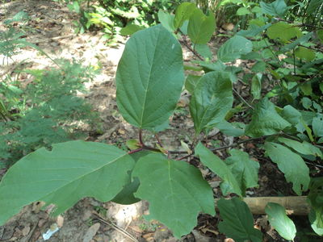
Classification of Mitragyna stipulosa
Kingdom: Plantae
Divison; Magnoliophyta
Class: Magnoliopsida
Family: Rubiaceae
Genus: Mitragyna
Specie: Stipulosa

Slide 8
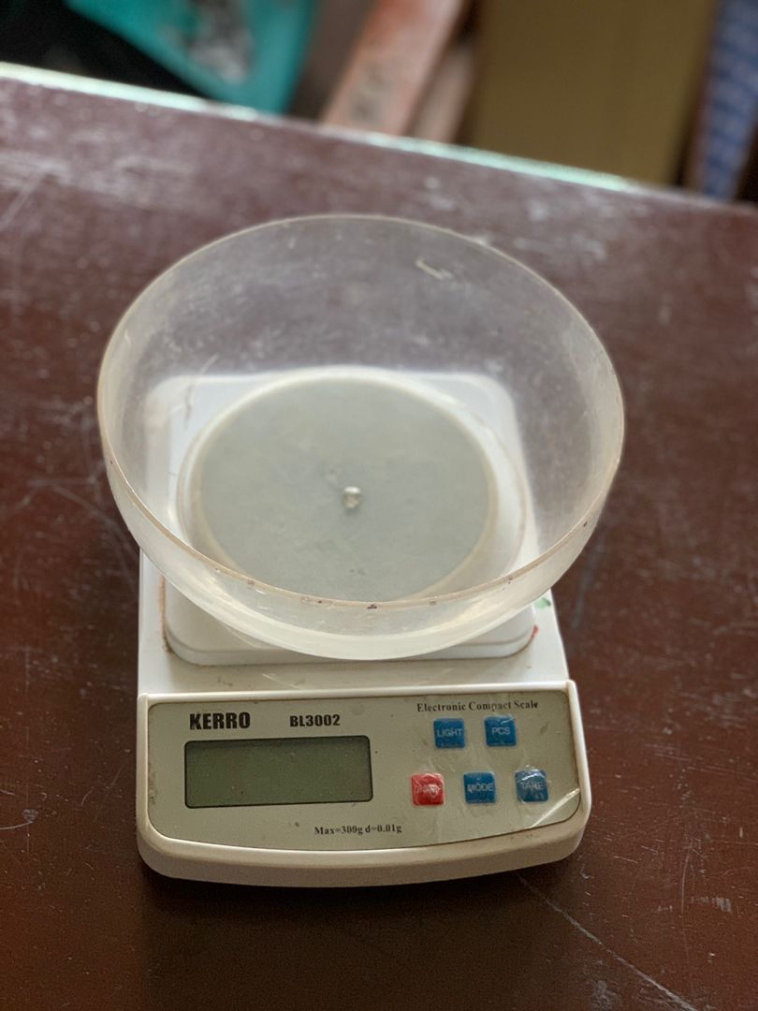
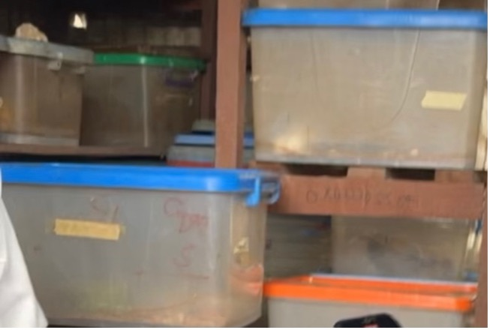
APPARATUS & CHEMICALS:
Weighing balance
Venier caliper
Distilled water
Reagent bottles
Cages
Sample bottles
Carrageenan
Normal saline
Ethanol

Slide 9
PREPARTION OF EXTRACT:
Leaves were air dried for 7 days and pulverized . The powered crude drug(500g) was macerated with 70%ethanol and 30%distilled water for 72 hours
Extract was filtered through a funnel covered with cotton wool and poured into a beaker. Filterate was evaporated to dryness in an oven to prevent decomposition of natural metabolites

Slide 10
ANALYSIS
Group 1: Saline(10ml/kg)
Group 2: Extract (50mg/kg)
Group 3: Extract (100mg/kg)
Group 4: Extract (200mg/kg)
Group 5: Aspirin 10mg/kg

Slide 11
PHYTOCHEMICAL SCREENING
TEST | INFERENCE
PHENOL | +
TERPENOIDS | -
SAPONINS | +
FLAVINOIDS | +
STEROIDS | -
ALKALOIDS | -
ANTHRAQUINONE | +
TANNIN | +
PHLOBATANIN | -

Slide 12
EFFECT OF LEAF EXTRACT
GROUP | DOSE | 0hrs | 1hr | 2hrs | 3hrs
CONTROL |  | 1.77 | 3.90 | 3.99 | 3.95
EXTRACT | 50 | 1.83 | 2.96 | 2.25 | 2.20
EXTRACT | 100 | 1.86 | 3.50 | 3.30 | 3.25
EXTRACT | 200 | 1.82 | 3.25 | 3.28 | 3.05
ASPIRIN | 10 | 1.84 | 3.25 | 3.01 | 2.40

Slide 13
CONCLUSION OF THE EXPERIMENT
In carrageenan induced edema, leaf extract of Mitragyna stipulosa was found to posses anti-inflammatory activity. The experiment supports the traditional application of this plant in treating diseases associated with inflammation and pain.

Slide 14
RELEVANCE TO COURSE OF STUDY

Slide 15
CONCLUSION

Slide 16
THANK YOU FOR LISTENING !!

